Slide 1


Gujarat Technological University
NEW L. J. INSTITUTE OF ENGINEERING AND TECHNOLOGY
DEPARTMENT OF IT
ACADEMIC YEAR – (2024-25)
Internship (3181601)
GYM Finder & Recommender
HOD NAME: Dr Gayatri Pandi IT, NEW LJIET.
GUIDED BY,
PROF. DIVYANG MAKWANA
PREPARED BY,
AASHISH HARIPARA
211430116040
SEMESTER: 8th DEPARTMENT OF IT

Slide 2
Outline
ABSTRACT
PROBLEMS IN EXISTING SYSTEM
PURPOSE OF THE PROJECT
FUNCTION REQUIREMENTS
SYSTEM MODULES
SYSTEM REQUIREMENTS
FRONT END AND BACK END OF SYSTEM
DATA DICTIONARY
SNAPSHOT OF WEBSITE
FUTURE ENHANCEMENT

Slide 3
ABSTRACT
Gym search and recommendations make choosing a gym easy by providing personalized recommendations based on user preferences, location, budget, and amenities. It collects and analyzes data from gyms within a certain radius to make accurate recommendations. Built on the MERN team and EJS standards, it integrates OAuth and JWT authentication for security. The system helps gym owners reach the right members while improving users’ decision-making capabilities through location-based search, real-time data updates, and insights.

Slide 4
2. PROBLEMS IN EXISTING SYSTEM
Limited Personalization: Most current systems cannot provide personalized recommendations based on a person’s interests,
Outdated or Incomplete information: Gym information like prices, equipment, trainers, and membership benefits are often outdated or incomplete, making it difficult for users to make informed decisions.
No flexibility or trial options: Current gym systems often lack flexibility when it comes to fitness classes or testing gym facilities.
Users are often forced to pay a monthly fees for no option of a good fit for their needs. Additionally, a lack of trial classes or safety measures limits user ability to try out gym services before making a long-term commitment.

Slide 5
3. PURPOSE OF THE PROJECT
The aim of gym search and recommendations is to provide users with effective and personalized solutions to find gyms based on their specific needs, location and budget.
The system aims to simplify the gym selection process by providing recommendations and detailed information about gyms in a specific area.
The program aims to improve user experience and promote healthy living through better access to exercise by integrating features such as adaptive changes, real-time data updates and personalized recommendations.
It also aims to empower gym owners by providing them with a digital platform to reach a wider audience and expand their membership base.

Slide 6
4. FUNCTION REQUIREMENTS
User Authentication & Authorization: Role based access for gym admin trainer or users.
Location Based Gym finder functionality: You can easily get the perfect gym that fulfills your location requirements.
Gym recommendation based on interest: You can find gym based on time, budget, gym-instruments, trainer facilities etc.
Easy n-days booking features: Unlike traditional gyms with rigid monthly memberships, our system offers a flexible 10-day booking option, allowing users to try out different gyms without committing to long-term contracts or monthly charges.
Secure payment integration: You can easily pay the membership fees with card, Online or net banking etc.

Slide 7
5. SYSTEM MODULES
User Authentication & Profile Management Module: Basic login/signup using email and password. Profile creation with fitness preferences and goals.
Gym Search & Filtering Module: Search gyms by location, budget, and available facilities. Filter options for gym type, trainers, and workout schedules.
Booking & Subscription Module: Simple gym booking for short-term(1-Week) or monthly plans. Option to cancel or modify bookings easily.
Review & Rating Module: Users can rate gyms and write reviews. Display average ratings and feedback to help new users.
Notification & Updates Module: Users get alerts on gym offers, new facilities, and schedule changes. Reminders for booked sessions or upcoming gym renewals.

Slide 8
6. SYSTEM REQUIREMENTS
Functional Requirements:
Search gyms based on location and preferences. Provide personalized gym recommendations. Allow short-term (10-day) bookings, not just monthly subscriptions. Gym owners can manage their gym profiles and pricing. Notify users about gym availability, offers, and renewals. Implement a review and rating system for gyms.
Non-Functional Requirements:
Performance: Search results should load within 3-5 seconds.
Scalability: Handle growing users and gym listings.
Security: Secure storage of user data and payment details.
Availability: 24/7 accessibility with minimal downtime.

Slide 9
7. FRONT END AND BACK END OF SYSTEM
Frontend Technologies: EJS for dynamic HTML templating, HTML, CSS, JavaScript for structure, styling.
Backend Technologies: Node.js with Express.js for server-side development, MongoDB for NoSQL database management, JWT for secure user authentication and authorization.
APIs & Services: Google Maps API for location-based gym search, Nodemailer for email notifications, Payment Gateways (Stripe) for secure transactions.
Development & Deployment: Git/GitHub for version control, VS Code for code development, AWS for deployment and hosting, Postman for API testing.

Slide 10
8. DATA DICTIONARY
User Collection
Field Name | Data Type | Description
_id | ObjectId | Unique identifier for each user
name | String | Full name of the user
email | String | User's email address
password | String (Hashed) | Encrypted password for user authentication
role | String | Defines user role (User, Trainer, Admin)
preferences | Array of String | User's fitness preferences like Yoga, Cardio, etc.
createdAt | Date | Account creation date
updatedAt | Date | Last profile update date

Slide 11
8. DATA DICTIONARY
Gym Collection
Field Name | Data Type | Description
_id | ObjectId | Unique identifier for each gym
name | String | Full name of the gym
location | String | Address or locality of the gym
contactNumber | String | Contact number for inquiries
ratings | Number | Average rating of the gym
createdAt | Date | Date when the gym was added
updatedAt | Date | Last update of gym details

Slide 12
8. DATA DICTIONARY
Booking Collection
Field Name | Data Type | Description
_id | ObjectId | Unique identifier for each booking
userId | ObjectId | Reference to the user who made the booking
gymId | ObjectId | Reference to the gym being booked
bookingDate | Date | Date of booking
duration | String | Booking duration (1 week, 1 month, etc.)
paymentStatus | String | Status of payment (Paid, Pending, Failed)

Slide 13
8. DATA DICTIONARY
Otp Collection
Field Name | Data Type | Description
_id | ObjectId | Unique identifier for each gym
email | String | Email of the user
otp | Number | 6 digit unique one time password

Slide 14
8. DATA DICTIONARY
Session Collection
Field Name | Data Type | Description
_id | ObjectId | Unique identifier for each session.
expires | Date | Expiration date and time of the session.
session | Object | Contains session data as an object.
session.cookie | Object | Contains cookie-related information of the session.
session.accessToken | String (JWT) | JWT token provided after successful login.

Slide 15
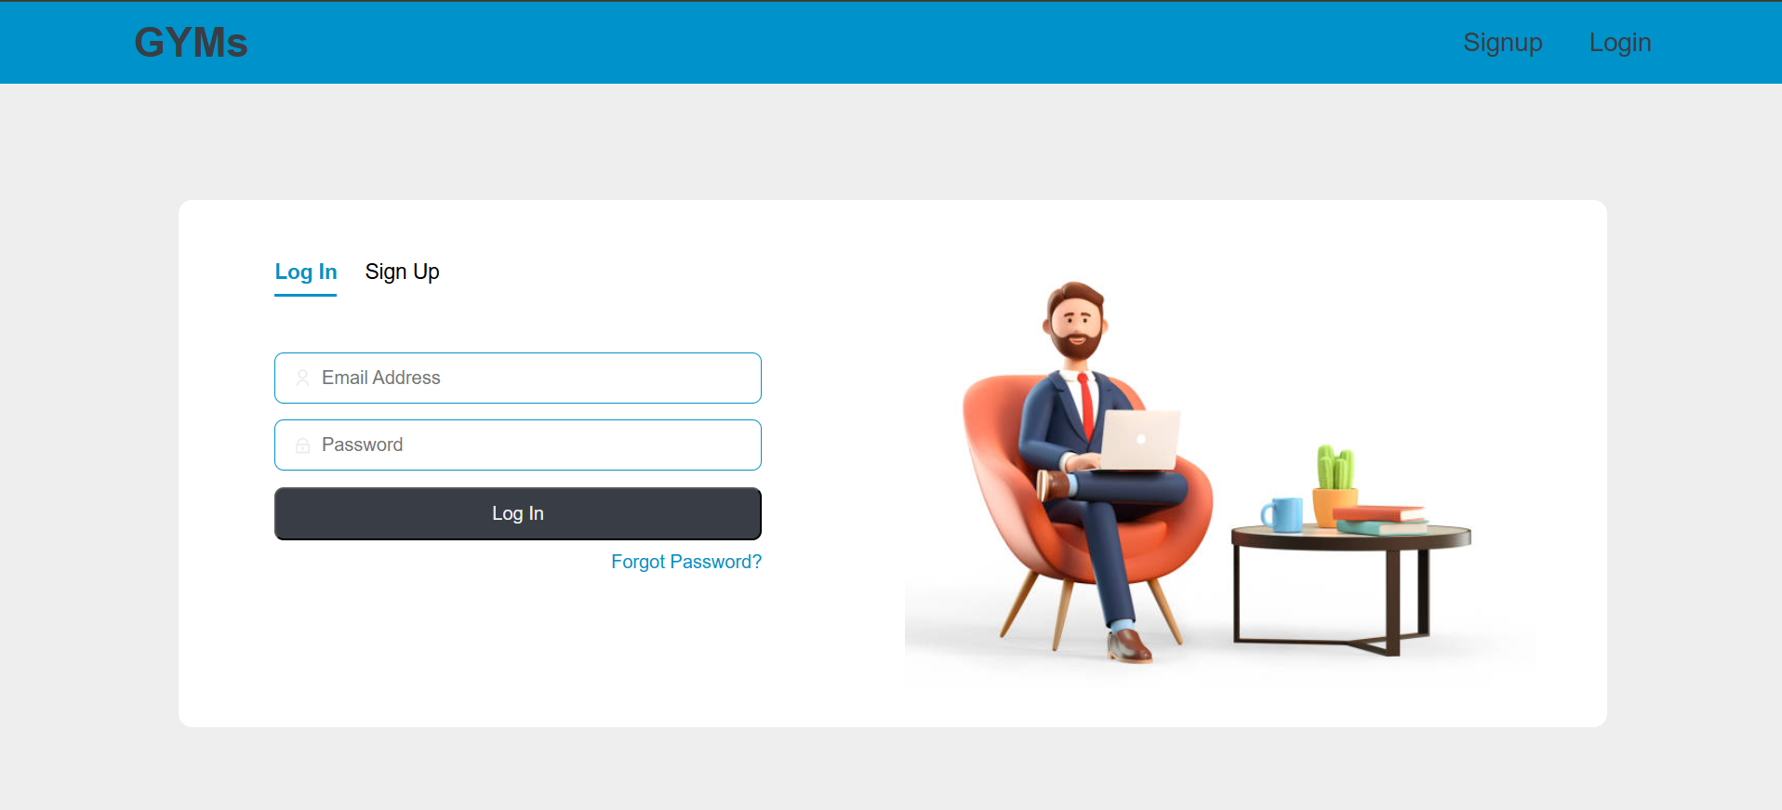
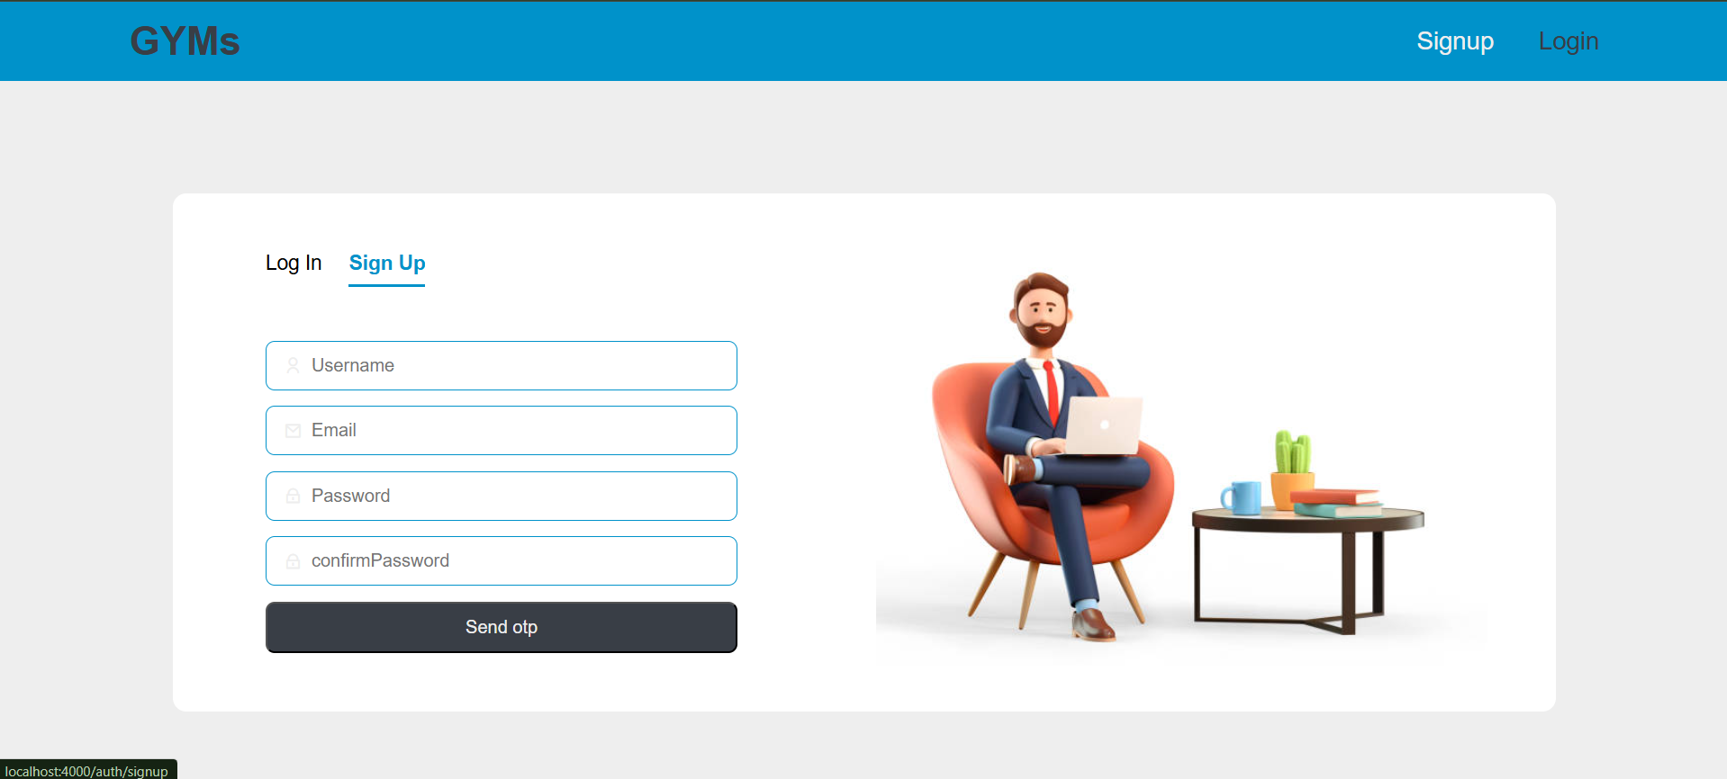
9. SNAPSHOT OF WEBSITE
Authentication:

Slide 16
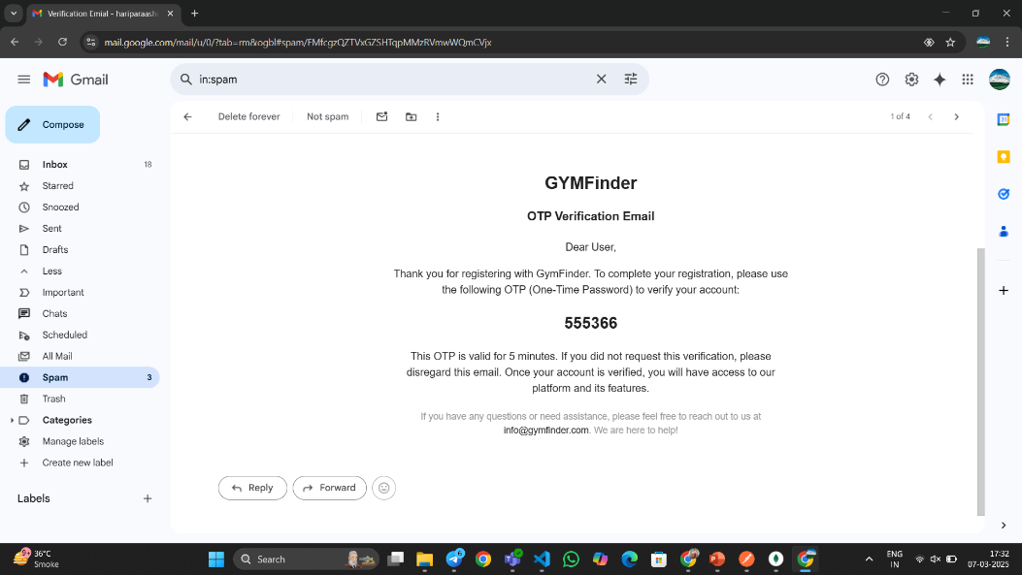
9. SNAPSHOT OF WEBSITE
Authentication:

Slide 17
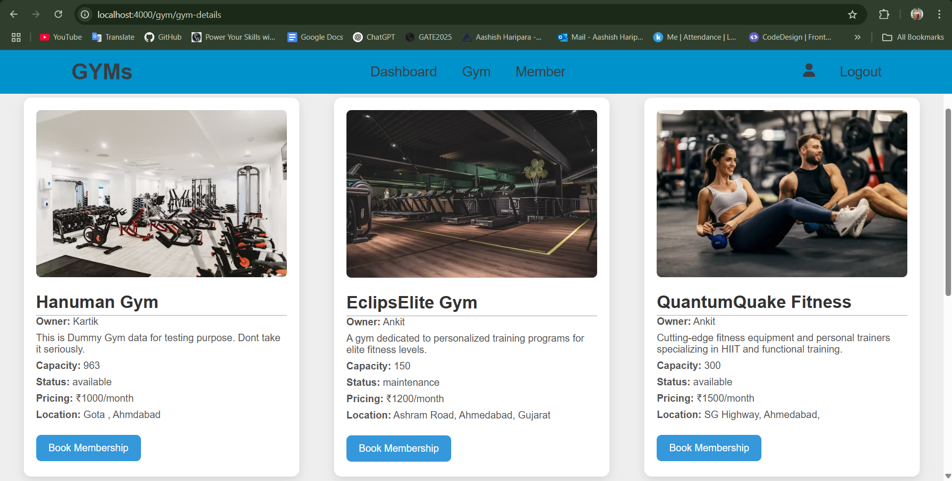
9. SNAPSHOT OF WEBSITE
Gym Details:

Slide 18
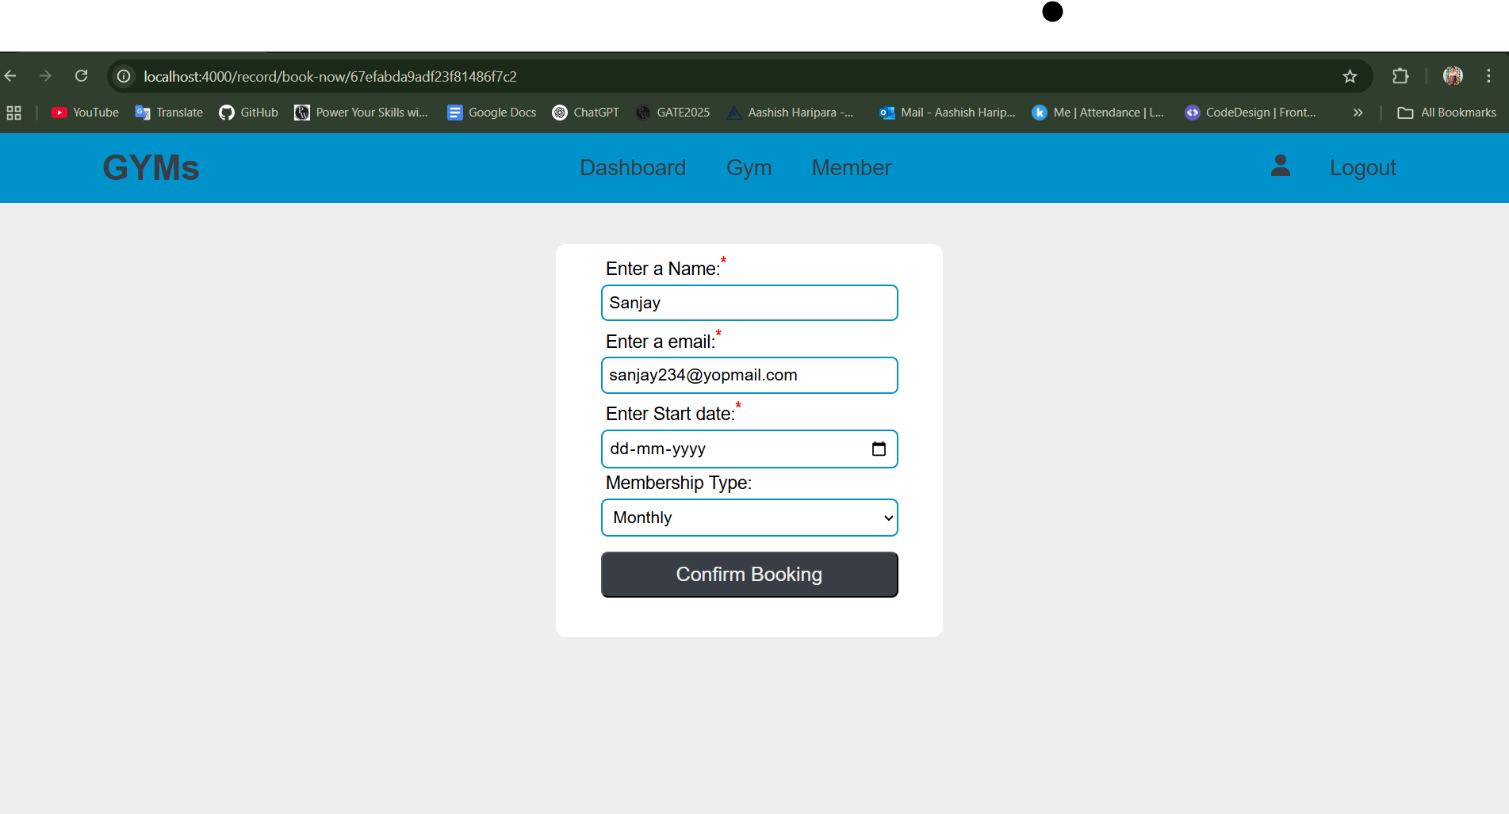
9. SNAPSHOT OF WEBSITE
Gym Booking:

Slide 19
10. FUTURE ENHANCEMENT
Personalized AI Recommendations : AI suggests gyms based on user preferences, location, and fitness goals, improving over time.
Advanced Analytics : Insights into gym popularity, peak hours, and user satisfaction for better decision-making.
Predictive Analytics :AI forecasts trends to help gyms optimize schedules and offer dynamic pricing.
Mobile Accessibility : Features like real-time occupancy, instant booking, and virtual tours enhance user experience.
Wearable Device Integration : Syncing with fitness trackers enables personalized workout recommendations.
Dynamic Membership Plans :Flexible pricing models based on real-time gym utilization.

Slide 20


